Slide 1


MiniGPT
Building and Training a Transformer Language Model
Sean Hall
MATES Class of 2026 Senior Capstone Project

Slide 2



Key Research Foundations
Bengio et al. (2003)
Vaswani et al. (2017)
Radford et al. (2019)
"A Neural Probabilistic Language Model"
"Attention Is All You Need"
"LMs are Unsupervised Multitask Learners"
The definitive Transformer architecture. Replaced recurrence with self-attention for massive parallelization.
Introduced distributed word representations to solve the curse of dimensionality in language modeling.
Demonstrated GPT-2's ability to perform zero-shot tasks without explicit supervision or parameter tuning.

Slide 3

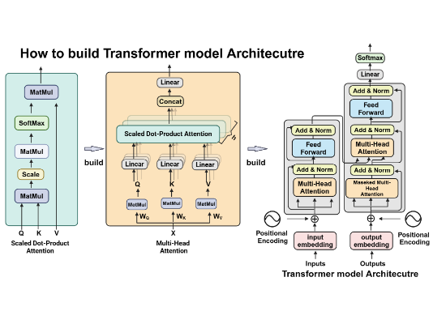
The Project Vision
Recreating GPT architecture on a computationally feasible scale to understand LLM fundamentals.
•
Decoder-Only Structure: Focused on next-token prediction.
•
Manual Implementation: Built from atomic components without high-level APIs.
•
Transparency: Deconstructing the "black box" through active engineering.

Slide 4
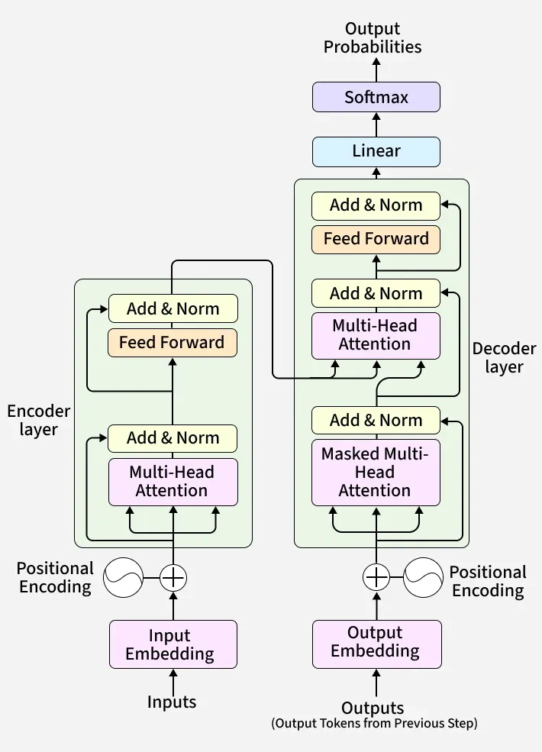

Slide 5


The Problem: Black Box Dynamics
Opaque Internals
Knowledge Gap
Large models are often used without an understanding of the underlying mathematical logic and data flow.
Entry-level positions increasingly demand deeper architectural knowledge beyond simple API consumption.

Slide 6





Why This Matters
Career Stepping Stone
Technical Mastery
Academic Legacy
Builds a high-value skill set for the competitive AI job market.
Deep dive into linear algebra, calculus, and neural network optimization.
Provides a technical reference for future student research in AI/ML.

Slide 7
Project Scope
In-Scope | Out-of-Scope
Decoder-only Transformer implementation | Large-scale training (multi-billion parameters)
BPE Tokenizer training & vocabulary | Distributed training across clusters
Training metrics: Loss & Perplexity | Reinforcement Learning (RLHF)
Prompt-based inference interface | Multimodal inputs (Image/Audio)

Slide 8

Technical Core
Causal Masking: Ensuring future tokens are hidden.
Embeddings: Learning high-dim vector spaces.
Multi-Head Attention: Scaled dot-product logic.
Residual Paths: Facilitating deeper training.

Slide 9



The Tech Stack
Python
PyTorch
GitHub
CUDA GPU
Leveraging GPU acceleration on local hardware for optimized training cycles.

Slide 10



Execution Timeline
Phase 1 (Wks 1-2)
Phase 2 (Wks 3-4)
Phase 3 (Wks 5-6)
Setup & Tokenizer
Architecture
Training Logic
Phase 4 (Wks 7-9)
Phase 5 (Wks 10-12)
Phase 6 (Wks 13-17)
Training Baseline
Inference & UI
Analysis & Final

Slide 11
Expected Outcomes
Functional Model: Fully implemented transformer model.
Coherent Generation: Capable of prompt-based text synthesis.
Performance: Target to match or exceed GPT-2 benchmarks on specific zero-shot tasks.
Visualizations: Clear metrics on loss reduction and perplexity trends.
Working Interface: A functional system for live demonstrations.

Slide 12
Feedback?
Questions and Comments
MiniGPT | Sean Hall | MATES 2026

